Slide 1


K.L.N.College of Engineering
An Autonomous Institution | Accredited by NAAC
(Approved by AICTE, New Delhi & Affiliated to Anna University, Chennai)
Department of Electronics and Communication Engineering
DDoS (Distributed Denial Of Service) ATTACK DETECTION USING MACHINE LEARNING
-----------Guided By--------
MR.S.R.NARESH
ASP/ECE
---------Presented By-----------------
MUKESH KUMAR R – 910619106032
NAVEEN KUMAR N – 910619106034
GNANA SEKAR P – 910619106016
PRAVEEN RAJ T – 910619106303

Slide 2
Introduction to the project
A DDoS attack is a type of attack where a large number of computers or devices are used to send a huge amount of fake traffic to a website or network, overwhelming it and making it unavailable to users.
In this project, different types of algorithm to predict the DDoS attack.
These algorithms can be used to detect the DDoS attack with greater accuracy.

Slide 3
Objectives
The primary objective of DDoS attack detection is to identify the attack as early as possible so that appropriate measures can be taken to prevent or minimize the damage caused by the attack.
By Using boosting algorithm over bagging algorithm, Boosting algorithm works sequentially whether bagging algorithm works parallel. So it's check sequentially and reduce the errors more than bagging algorithm.

Slide 4
Literature Survey
S.No | Title | Author Name | Objective | Disadvantage
1. | Hybrid Deep Learning – based Anomaly Detection Scheme for Suspicious Flow Detection in SDN. | Sahil Garg , Kuljeet Kaur , Neeraj Kumar ,Joel J.P.C.Rodrigues | The paper aims to provide insights into which machine learning algorithms are most effective for detecting DDoS attacks | They have used Bagging algorithms like SVM, Naïve Bayes,etc..
2. | DDoS Attack Detection Using Machine Learning Techniques | Shuang Wang, Qinghe Du, and Yanan Sun | The main goal of the paper is to provide a comprehensive review of the state of the art in DDoS attack detection using machine learning techniques, and to identify the key research challenges and opportunities in this area | The study only used a limited set of features to detect DDoS attacks, which may not be sufficient to accurately detect all possible types of DDoS attacks.
3. | A Comparative Analysis of Machine Learning Algorithms for DDoS Attack Detection | Mohammad A. Al-Faraj, Khaleel M. Al-Salem, and Abdulaziz Al-Shetwi | The main goal of the paper is to contribute to the body of knowledge on DDoS attack detection and to help practitioners make more informed decisions about how to detect and respond to DDoS attacks. | The study used a small dataset with only two types of DDoS attacks, which may not be representative of all possible types of DDoS attacks.

Slide 5
4. | A Novel Method for Detecting DDoS Attacks Based on Random Forest Algorithm | Meng Liu, Shengli Liu, and Huaqi Wang | The paper aims to provide insights and recommendations for researchers and practitioners who are interested in developing or implementing machine learning-based DDoS attack detection systems. | The study did not test the algorithms in a real-world environment, which may have different characteristics and performance compared to the controlled environment of the study
5. | Anomaly-based DDoS Detection Using Deep Learning | Andra Lutu, Valerio Bruschi, and Alberto Dainotti | To identify the strengths and weaknesses of different machine learning algorithms for detecting DDoS attacks. | The approach proposed in the paper may not be scalable to large-scale networks

Slide 6
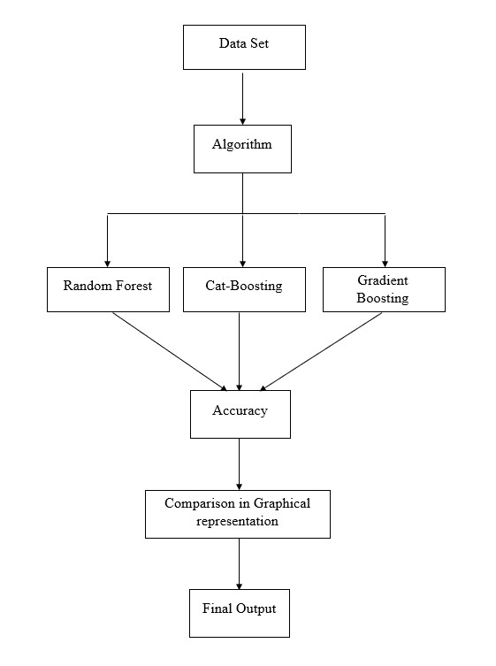
Block Diagram

Slide 7
Proposed System
The Datasets have been from “KAGGLE DATASET” website.
In our project we have used mainly three algorithms ;
1. Random Forest
2. Cat-Boost Classifier
3. Gradient-Boosting

Slide 8
Random Forest Algorithm
Random Forest is a popular machine learning algorithm used for both classification and regression tasks. It is an ensemble learning method that combines multiple decision trees to make predictions.
Random Forest is a powerful and flexible algorithm that can handle large and complex datasets with high accuracy and generalization capabilities.

Slide 9
Cat-boost Algorithm
Cat-Boost is a boosting algorithm that is based on decision trees. It works by iteratively training decision trees on the residual errors of the previous trees, thereby reducing the error with each iteration.
It uses a technique called ordered boosting that enables it to handle categorical data better than other gradient-boosting frameworks.

Slide 10
Gradient Boosting Algorithm
Gradient Boosting is a powerful and widely used algorithm in machine learning, and is suitable for a variety of applications.
Its ability to handle complex and heterogeneous data, and produce accurate predictions
The strength of Gradient Boosting lies in its ability to combine weak prediction models to create a strong and accurate model.

Slide 11
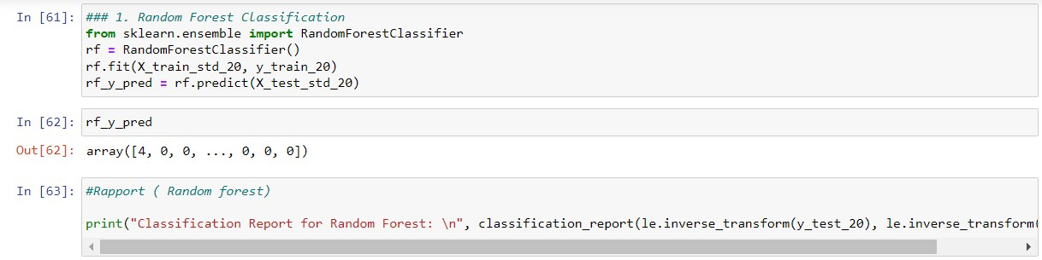
Screenshots of Software Implementation
Random Forest

Slide 12
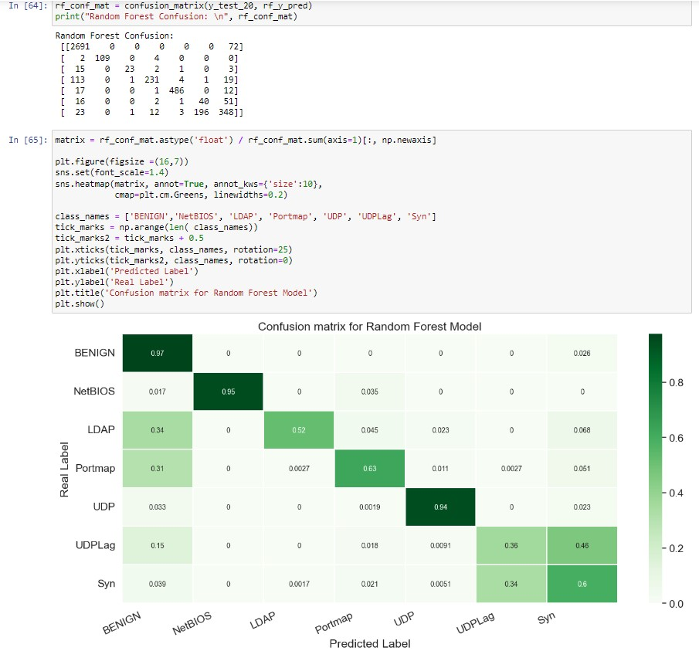

Slide 13


Slide 14
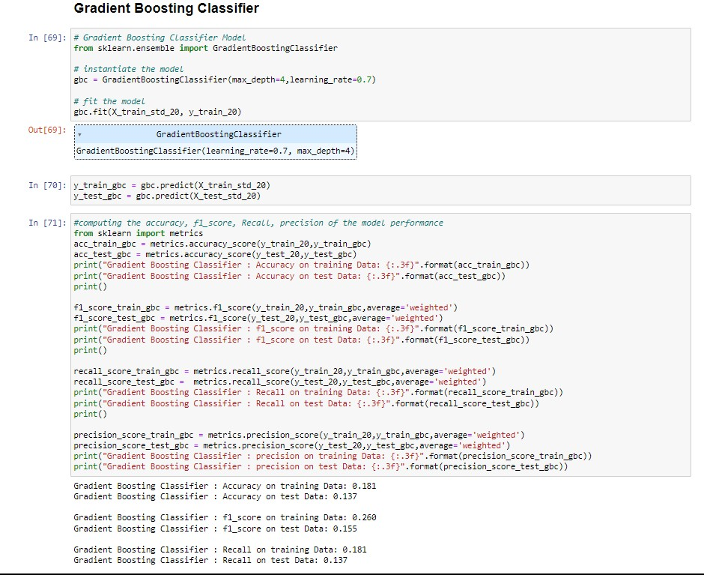
Gradient Boosting

Slide 15


Slide 16
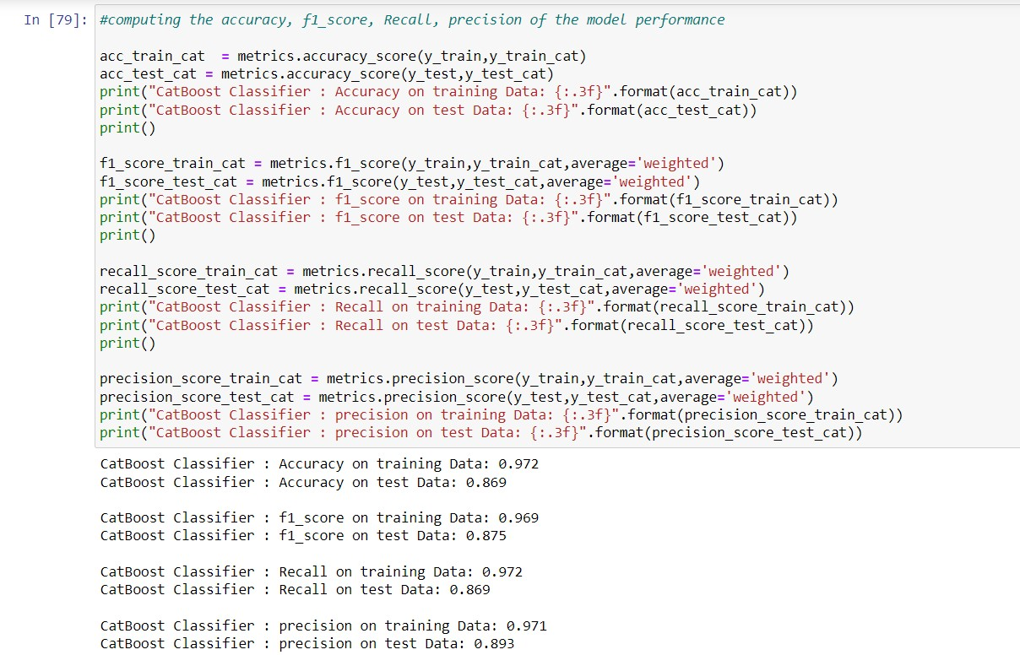
Cat-Boosting

Slide 17


Slide 18
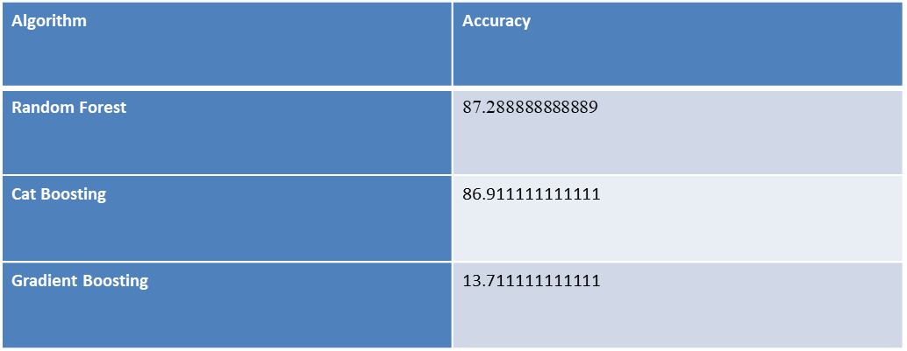
Performance Metric and Comparison Table

Slide 19
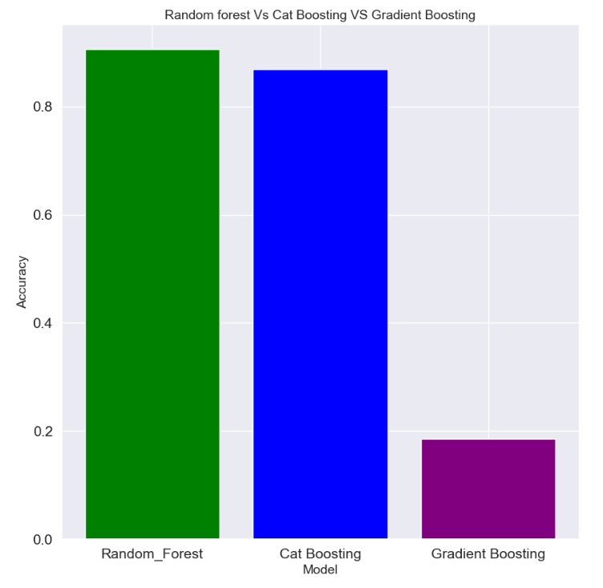
Graphical Representation of Algorithms

Slide 20
Result and Discussion
We have trained the Random Forest algorithm which has high accuracy than comparing other algorithms like Cat Boosting and Gradient Boosting.
So we conclude that our trained Random Forest model as best model for DDoS detection. Cat Boosting can also be used for DDoS detection since it has accuracy of 86.91

Slide 21
Conclusion
New machine learning techniques and models that can efficiently manage remote networks and diverse data sources are likely to be developed as a result of the expanding use of cloud computing and edge computing.
These new algorithms must be able to process enormous amounts of data in real-time and recognise tiny patterns and anomalies that could be signs of DDoS attacks
Deep learning and neural network developments will probably make DDoS attack detection more sophisticated and precise.

Slide 22
References
S. Garg, K. Kaur, N. Kumar and J. J. P. C. Rodrigues, "Hybrid Deep-Learning-Based Anomaly Detection Scheme for Suspicious Flow Detection in SDN: A Social Multimedia Perspective," in IEEE Transactions on Multimedia, vol. 21, no. 3, pp. 566-578, March 2019, doi: 10.1109/TMM.2019.2893549.
https://ieeexplore.ieee.org/document/8613868
M. Zekri, S. E. Kafhali, N. Aboutabit and Y. Saadi, "DDoS attack detection using machine learning techniques in cloud computing environments," 2017 3rd International Conference of Cloud Computing Technologies and Applications (CloudTech), Rabat, Morocco, 2017, pp. 1-7, doi: 10.1109/CloudTech.2017.8284731
"A Novel Method for Detecting DDoS Attacks Based on Random Forest Algorithm" by Meng Liu, Shengli Liu, and Huaqi Wang, in IEEE Access, 2019.

Slide 23
Shone, T. N. Ngoc, V. D. Phai and Q. Shi, "A Deep Learning Approach to Network Intrusion Detection," in IEEE Transactions on Emerging Topics in Computational Intelligence, vol. 2, no. 1, pp. 41-50, Feb. 2018, doi: 10.1109/TETCI.2017.2772792.
Hussain, Q. Du, B. Sun and Z. Han, "Deep Learning-Based DDoS-Attack Detection for Cyber–Physical System Over 5G Network," in IEEE Transactions on Industrial Informatics, vol. 17, no. 2, pp. 860-870, Feb. 2021, doi: 10.1109/TII.2020.2974520.
" Iqbal, H., Ali, S., & Aslam, F. (2021). DDoS Attack Detection using CatBoost Algorithm with Feature Selection and Dimensionality Reduction. International Journal of Advanced Computer Science and Applications (IJACSA), 12(2), 18-23. doi: 10.14569/IJACSA.2021.0120203

Slide 24

Conference

Slide 25


Slide 26


Slide 27


Slide 28
Thank You

